Slide 1
Web Dynpro ABAP

Slide 2
Web Dynpro ABAP - Introduction
The abbreviations for Web dynpro for ABAP or Web dynpro ABAP is WD4A or WDA.
Web dynpro ABAP is a combination of 3 words - web means internet, dynpro means – dynamic programs/applications, ABAP - programming language.
Web dynpro ABAP is the standard UI technology for developing web applications in the ABAP environment.
Web dynpro ABAP consists of graphical development environment with special web dynpro tools that are integrated in the ABAP workbench(SE80).

Slide 3
Web Dynpro ABAP - Introduction(Contd.)
Web dynpro application is equal to module pool program of core ABAP.

Slide 4
Web Dynpro ABAP - Architecture(MVC)
Web dynpro ABAP is based upon MVC(Model View Controller) architecture.
View - View is user interaction part. All UI elements like input field, drop downs are the part of view.
Controller - Controller acts as an interface between view and the model.
Model - It corresponds to business logic part.

Slide 5
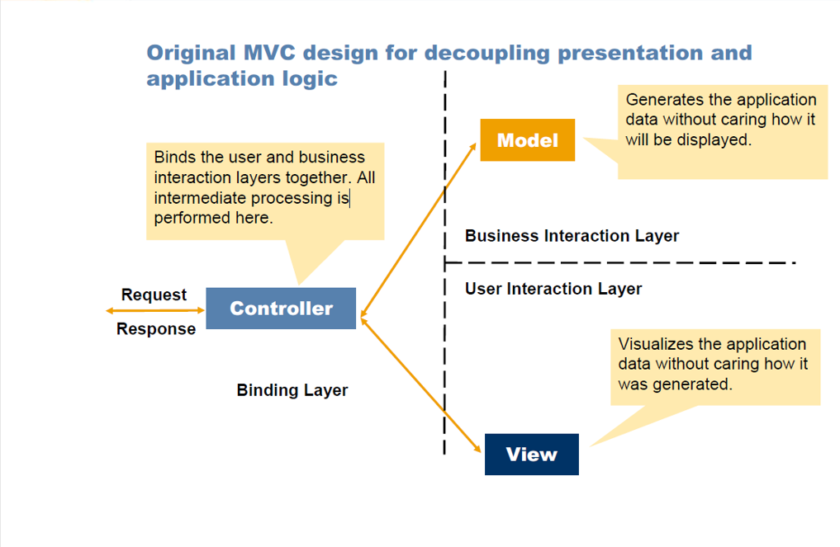
Web Dynpro ABAP - Architecture(MVC)

Slide 6
Web Dynpro ABAP - Advantages
Fully integrated into ABAP development environment.
There is a strict separation between layout and business data(MVC). Developing web applications using the MVC architecture allows one developer to work on a particular section (say, the view) while another can work on any other section (say, the controller) simultaneously , so it results in to faster development.
Reusability of one web dynpro component in to another component.

Slide 7
Web Dynpro ABAP - Advantages(Contd.)
The use of declarative and graphical tools significantly reduces the implementation effort.
Layout and navigation can be easily changed using web dynpro tools.

Slide 8
Web Dynpro ABAP - Limitations
No mobile device support - Web dynpro ABAP is used only for desktop-based web applications, it does not support mobile devices.
No SAP GUI support - The use of Web dynpro applications inside SAP GUI is not supported.
No support for SAP GUI screens/programs - We can not call SAP GUI programs/screens from Web dynpro ABAP using the statements CALL SCREEN, SUBMIT etc.

Slide 9
Parts of Web Dynpro Component
When we create a web dynpro component the system by default shows the below mentioned parts.
Component Controller
Component Interface
Views
Windows

Slide 10
Parts of Web Dynpro Component
Component Controller - It is the backbone of the web dynpro component. Each web dynpro component contains exactly one component controller. It is like a global part of web dynpro component. The component controller is visible for all views in a component.
Views - The view is the smallest unit of a web dynpro application visible for the user. It is used to design the layout.

Slide 11
Parts of Web Dynpro Component
Component Interface - Each component has an interface which helps for the communication between web dynpro components.
Window - A window is used to combine several views .A view can only be displayed by the browser if it has been embedded in a window.

Slide 12
OTR
OTR stands for Online Text Repository.
It is a central location for the texts which provide services for managing the texts.
The main task of OTR is to support the creation and translation of texts.
The OTR texts can easily be reused.
The main advantage of using OTR is that the object itself is separate from the texts.
It means we can translate the texts independently of the object.

Slide 13
OTR(Contd.)
The OTR’s are maintained using the transaction code SOTR_EDIT.
Tables to store OTR short text - SOTR_HEAD(header table) , SOTR_TEXT(text table).
Tables to store OTR long Text - SOTR_HEADU(header table) , SOTR_TEXTU(text table).

Slide 14
OTR - Transaction Code SOTR_EDIT
The various parts of SORT_EDIT transaction code are as follows:
Text Type - The OTR differentiates between short text up to 255 characters in length and long text of any length. Choose the short text or long text.
Language - Provide the OTR creation language.
Package - Provide the package name.
Alias - Provide the unique alias name( shortcut). SAP automatically convert it to package name/alias name.

Slide 15
OTR - Transaction Code SOTR_EDIT(Contd.)
Object Type - Provide the object type.
Text - Provide the text.
Concept - SAP automatically generates the unique internal number that identifies an OTR text.

Slide 16
OTR - Class CL_WD_UTILITIES
The method GET_OTR_TEXT_BY_ALIAS of class CL_WD_UTILITIES is used to get the OTR text.

Slide 17
Context Attribute - Input Help Modes
The various ways to assign the input help to the context attribute are as follows:
Automatic : The search help from the dictionary is assigned to the type of the attribute. The search help is displayed in the property ‘determined input help’ and cannot be changed.
Dictionary Search Help : The search help to be specified in property ‘dictionary search help’ that has to be defined in the dictionary.

Slide 18
Context Attribute - Input Help Modes(Contd.)
Object Value Selector : The input help is executed by standard component WDR_OVS. The name of this component usage has to be specified in property ‘OVS component usage’.
Freely Programmed : The input help is freely programmed. In freely programmed search help, we create our own web dynpro component and use that component to provide input help to the field. The name of this component usage has to be specified in property ‘input help component usage’.

Slide 19
Context Attribute - Input Help Modes(Contd.)
Deactivated - No value help for the context attribute.

Slide 20
Context Attribute - Input Help Mode - Freely Programmed
The various steps for the freely programmed input help are as follows:
The web dynpro component which is to be used as input help must implement the web dynpro component interface IWD_VALUE_HELP.
After implementing the interface, a window is automatically created in our component with the name WD_VALUE_HELP.
We need to embed the view of our component to window WD_VALUE_HELP so that our view will be displayed as search help when the user triggers the F4.

Slide 21
Context Attribute - Input Help Mode - Freely Programmed(Contd.)
This component created for providing search help can be added as a used component in another web dynpro component.
Go to the attribute, choose the input help mode as freely programmed search help and pass the component usage in the property ‘input help component usage’.

Slide 22
Hook Methods
Hook methods are pre-defined methods in web dynpro ABAP.
They appear automatically when we create a web dynpro component.
Hook methods are specific to component controller, window and view.
We can check the hook methods by going into ‘Methods’ tab of respective part.
All hook methods starts with WDDO.

Slide 23
Hook Methods - Important Points
We can not call hook methods. They executes automatically at runtime .
The timing of the hook method execution is predefined in the web dynpro phase model.
We can add our own logic to these hook methods.

Slide 24
Hook Methods - Component Controller
The various hook methods at component controller level are as follows:
WDDOAPPLICATIONSTATECHANGE - Handling for suspending and resuming an application.
WDDOBEFORENAVIGATION - Error handling by application before navigation.
WDDOEXIT - Controller clean-up method.
WDDOINIT - Controller initialization method.
WDDOPOSTPROCESSING - Preparation of output.

Slide 25
Hook Methods - View
The various hook methods at view level are as follows:
WDDOAFTERACTION - Method for non-action specific operations before navigation.
WDDOBEFOREACTION - Method for validation of user input.
WDDOEXIT - Controller clean-up method.
WDDOINIT - Controller initialization method.
WDDOMODIFYVIEW - Method for modifying the view before rendering.
WDDOONCONTEXTMENU - Method for modifying the context menu.

Slide 26
Hook Methods - Window
The various hook methods at window level are as follows:
WDDOEXIT - Controller clean-up method.
WDDOINIT - Controller initialization method.
WDDOONCLOSE - Handling when closing the window.
WDDOONOPEN - Handling when opening the window.

Slide 27
Hook Methods - View - WDDOINIT
WDDOINIT method calls before displaying a particular view.
This method calls only once during the initialization of the view.
It is just like an INITIALIZATION event of classical reports.
The various purposes of WDDOINIT method are as follows:
Its purpose is to provide the initial values to the attributes.
Its purpose is to populate the context node with initial data.
It's a good place to write one time initialization logic.

Slide 28
Hook Methods - WDDOINIT - Triggering Sequence
WDDOINIT method is available at component controller level, view level and window level.
The right sequence of triggering of this method is as follows:
WDDOINIT of component controller
WDDOINIT of window
WDDOINIT of view

Slide 29
Hook Methods - View - WDDOMODIFYVIEW
This method also calls before displaying a particular view.
This method calls every time before displaying a particular view.
This method is just like an AT SELECTION-SCREEN OUTPUT event of classical reports.
The purpose of this event is to modify the view UI elements properties dynamically.
The method has one parameter FIRST_TIME, that indicates whether view is being displayed for the first time.
FIRST_TIME = ‘X’ ( first display of view ) , FIRST_TIME = ‘ ’ ( subsequent display of view).

Slide 30
Hook Methods - View - WDDOMODIFYVIEW(Contd.)
Imp point : As this method calls every time before displaying a particular view, so avoid writing the selection logic in this method.

Slide 31
Hook Methods - View - WDDONIT Vs. WDDOMODIFYVIEW
WDDOINIT method is a part of component controller , view and window whereas WDDOMODIFYVIEW method is a part of view only.
WDDONIT method calls only once before displaying a particular view whereas WDDOMODIFYVIEW calls every time before displaying a particular view.
WDDONIT method is just like an INITILIZATION event of classical reports whereas WDDOMOFIYVIEW is just like AT SELECTION-SCREEN OUTPUT event of classical reports.

Slide 32
Hook Methods - View - WDDONIT Vs. WDDOMODIFYVIEW(Contd.)
The major purpose of WDDOINIT method is used to assign the default values whereas the major purpose of WDDOMODIFYVIEW method is to modify the UI element properties dynamically.
WDDOINIT method does not have any parameter FIRST_TIME whereas WDDOMODIFYVIEW method has a parameter FIRST_TIME that indicates whether view is being displayed for the first time.

Slide 33
Hook Methods - View - WDDOBEFOREACTION
Whenever there is any action, before calling the event handler of action, WDDOBEFOREACTION method gets called.
The purpose of this method is to validate the input.
It is just like AT SELECTION-SCREEN event of classical reports.
Imp point : Web dynpro framework automatically restricts to enter into event handler method, if any attribute related error messages are there in WDDOBEFOREACTION method.

Slide 34
Thank You

